Slide 1
WEB TECHNOLOGIES

Slide 2
Syllabus
UNIT I
The World Wide Web (WWW), Importance of Hypertext and Hypertext Markup Language, HTML4.1 Common tags- List, Tables, images, forms, frames, Cascading Style Sheets
UNIT II
Introduction to Java Scripts, Dynamic HTML with Java Script, Objects in Java Script, popup windows in JavaScript(alert, prompt, confirm),function declaration usage in JavaScript, Event Handling.

Slide 3
UNIT III
XML: Document type definition, XML Schemas, presenting XML using XSLT, Document Object model, reading the XML document using parsers, DOM parser and SAX parser.
UNIT IV
Importance Web Servers and Application servers in a JAVA based enterprise application development. Installing the Java Software Development Kit, Tomcat Server & Testing Tomcat.
Introduction to Servelets: Lifecycle of a Serverlet, The Servelet API, The javax.servelet package, Reading request parameters, Reading Initialization parameters, reading the context parameters, The javax.servelet.http package, Handling Http Request & Responses, Session Tracking using URL rewriting, Hidden form fields, Cookies, HttpSession, Security Issues in web Application.

Slide 4
UNIT V
Introduction to JSP: The Problem with Servelet. The Anatomy of a JSP Page, JSP Processing: JSP Application Design with MVC.
JSP Application Development: Generating Dynamic Content, Using Scripting Elements Implicit JSP Objects.
UNIT VI
Database Access: Database Programming using JDBC, Metadata manipulations through JDBC, Importance of PreparedStatement and CallableStatement, Studying javax.sql. package, Accessing a Database from a JSP Page, performing the CRUD operations using JDBC API , importance of a framework usage in a java based web application development, introduction to Struts framework, struts application flow , sample application development using Struts API, Importance of from bean, action and struts-config.xml in a struts application.

Slide 5
TEXT BOOKS:
Web programming building internet applications by Chris Bates 2nd edition
Head First Servlets & JSP by Bryan Basham, Kathy Sierra, Bert Bates, Publisher: O’Reilly Media
REFERENCE BOOKS:
Programming World Wide Web by Sebesta.
Thinking In Java 4th Edition by Bruce Eckel
Learning XML by Erik T. Ray
Core SERVLETS ANDJAVASERVER PAGES VOLUME 1: CORE TECHNOLOGIES By Marty Hall and Larry Brown
Internet and World Wide Web – How to program by Dietel and Nieto
Database Programming with JDBC & Java by George Reese
Jakarta Struts Cookbook by Bill Siggelkow

Slide 6
What is WEB TECHNOLOGY ?
Technology associated with management of data on the world wide web.
Management of data?
communication,
information sharing,
interoperability,
user-centered design
and collaboration on the World Wide Web.

Slide 7
INTRODUCTION
World wide web : It is a system of interlinked hypertext documents accessed via internet with a web browser. (or)
An information system on the Internet which allows documents to be connected to other documents by hypertext links, enabling the user to search for information by moving from one document to another.
Web : network consisting of a collection of websites.
Website: collection of web pages maintained by a single person or organization.

Slide 8
A website has a distinct fully qualified domain name
Ex:- www.google.com.
Every website is made up of one or more web pages.

Slide 9
UNIT-I
Contents:
HTML Introduction
Common tags –List, Tables, images
Forms
Frames
Cascading Style sheets

Slide 10
HTML Introduction
web pages are written in HyperText Markup Language (HTML).
Web pages contain text ,hyperlinks (links to other web pages), tables, images.
Less commonly, web pages may also contain Flash animations, Java applets, or MPEG video files.

Slide 11
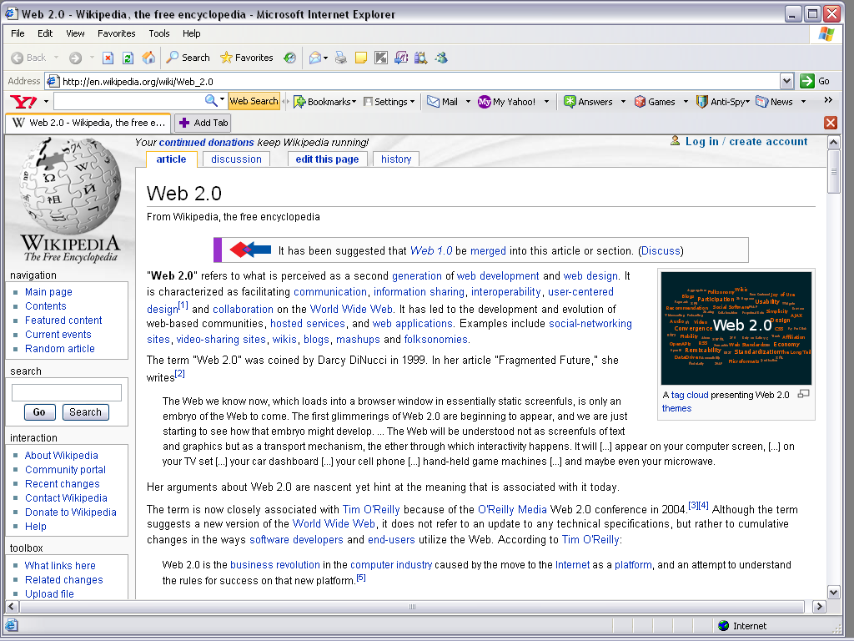
Example of Web Page

Slide 12
What is Markup and Hyper text
Markup: Markup refers to the sequence of characters or other symbols that you insert at certain places in a text or word processing file to indicate how the file should look when it is printed or displayed or to describe the document's logical structure. The markup indicators are often called "tags.
Hypertext:Apart from text, hypertext is sometimes used to describe tables, images and other presentational content forms with hyperlinks.
is text which contains links to other texts.

Slide 13
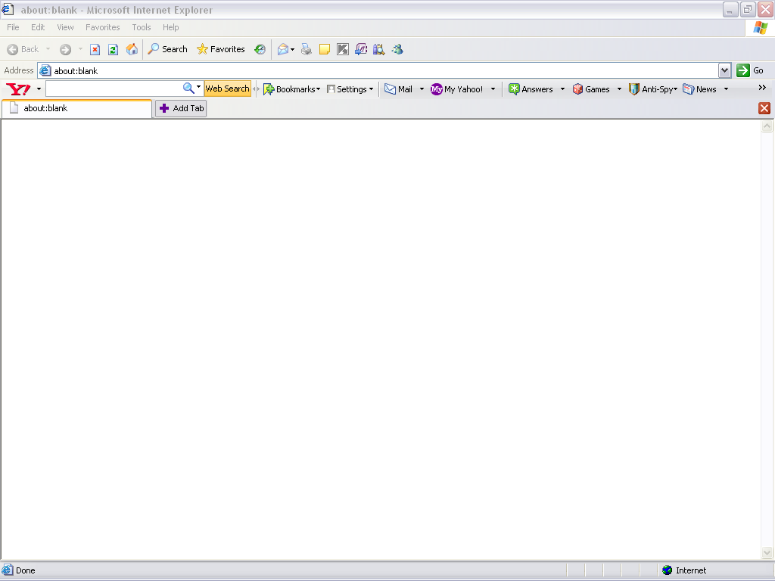
WEB BROWSER
Web browsers are software programs that allow users to access the web’s content.
Ex: Internet Explorer

Slide 14
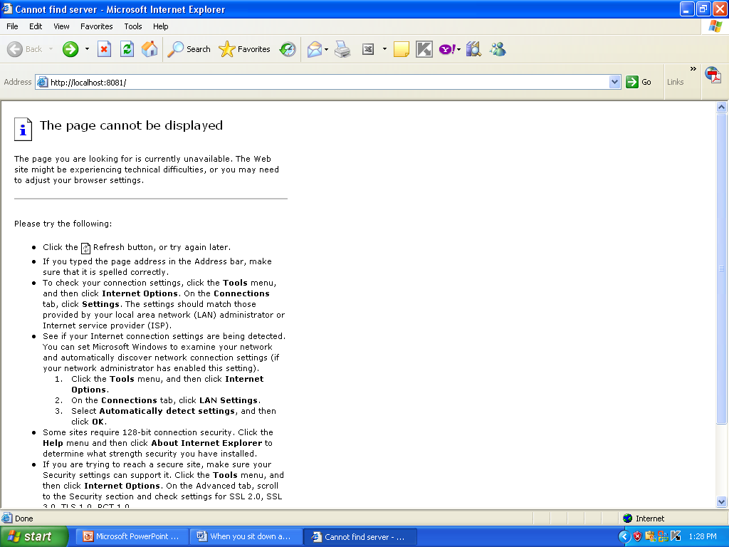
Title bar
Menu bar
Tool bar
Address bar
Status bar

Slide 15
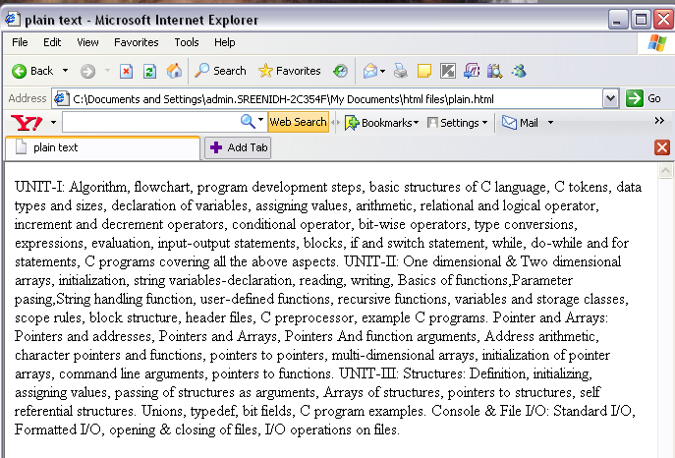
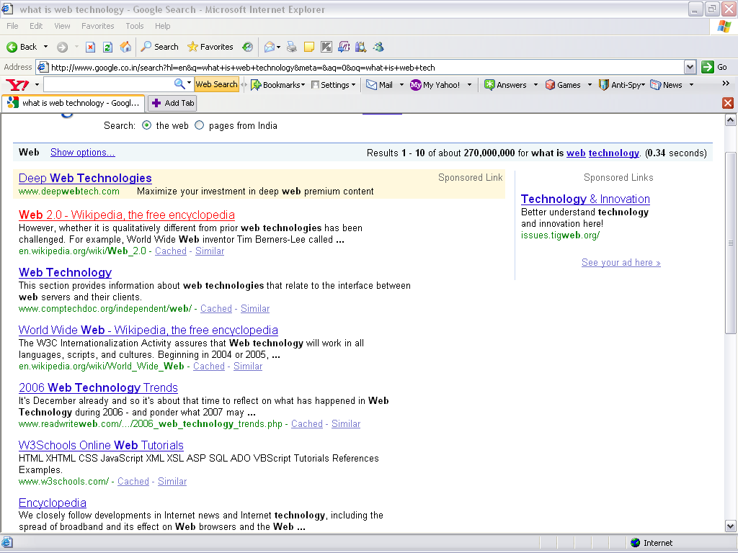
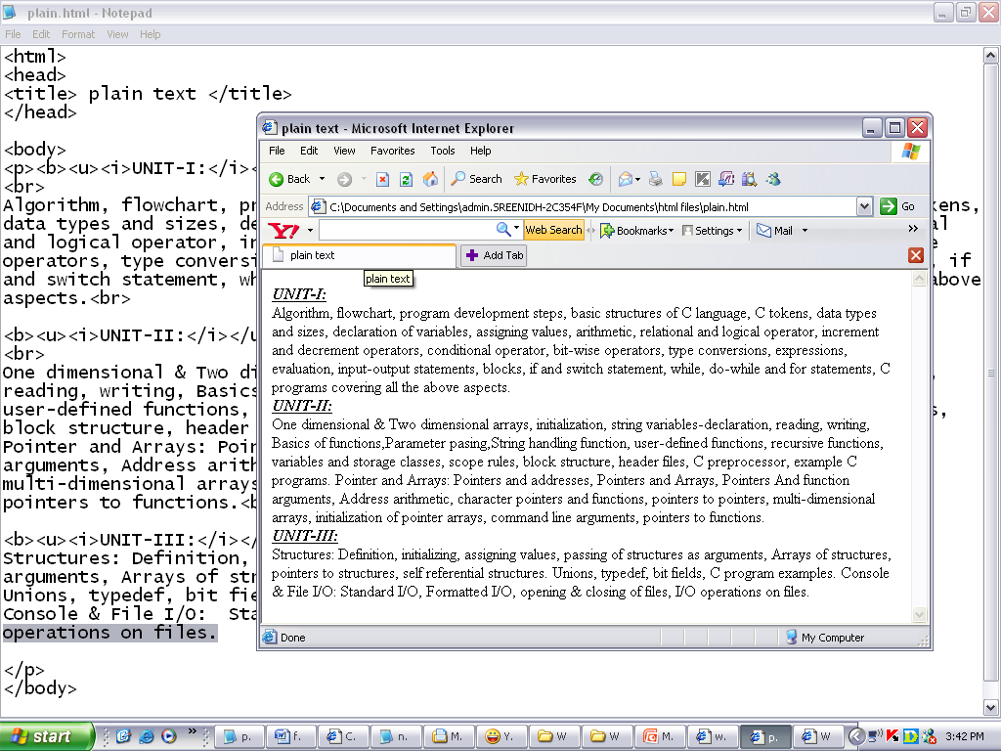
CATEGORIES OF TEXT
Plain text- Strings of characters of fixed font size.
Rich text -Strings of characters of various font size.
Hypertext – Plain / Rich text plus links to other documents.

Slide 16
Need of HTML
HTML is a language used to design web pages.
Without HTML, Web browsers take contents of web page and put them just like a paragraph without any line breaks, alignments etc .
With HTML , we can specify line breaks , alignments of text , images etc
In other words ,HTML is all about specifying structure and format of web page.

Slide 17
HTML Tags
HTML tags are used to mark-up HTML elements.
The surrounding characters are called angle brackets.
HTML tags normally come in pairs like <b> and </b>.
The first tag in a pair is the start tag, the second tag is the end tag.
HTML element : start tag , content ,end tag
HTML tags are not case sensitive, <b> means the same as <B>

Slide 18
HTML File
An HTML file is a text file containing small markup tags.
The markup tags tell the Web browser how to display the page.
An HTML file must have an htm or html file extension.
An HTML file can be created using a simple text editor.

Slide 19
GENERAL FORM OF HTML file
<html>
<head>
<title>Title of the page
</title> </head>
<body>
Content of the page
</body>
</html>

Slide 20
EXAMPLE
<html>
<head>
<title>This is my first web page ! </title>
</head>
<body>
<b> welcome to snist </b>
</body>
</html>

Slide 21
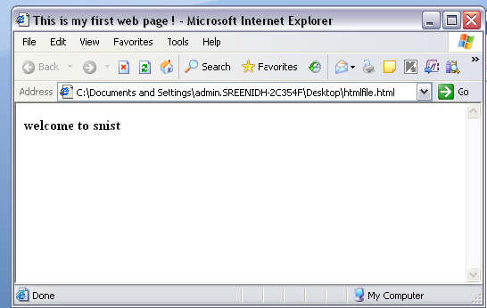

Slide 22
General points
Tag <HTML> indicates this page is written in HTML language.
HTML page contains two main section , HEAD and BODY.
HEAD section includes information about the page such as its title, page formatting instructions, scripts etc.
The BODY section includes actual content of the page.
Tags can be nested to create complex structures.
All tags may not need its closing tag.

Slide 23
Attribute
Attribute : keyword that is added INSIDE another tag
Used to add functions where that tag is in effect. For example, the BODY tag can contain the background color,
<BODY BGCOLOR="BLUE">.
The end tag </BODY> does not have to contain the attribute. The background color will be in effect throughout the document.
General form: <tagname attribute=“value”>

Slide 24
Common HTML tags:-
Understanding the following table:
The first two columns show the opening and closing tags . Note that just a few tags do not have a closing tag.
The attribute column shows list of attributes that can be placed inside of that tag.
The Description column tells what the tag does.

Slide 25
Document Structure
Opening Tag | Closing Tag | Attribute | Description
<HTML> | </HTML> |  | Identifies document as HTML
<HEAD> | </HEAD> |  | Document Head contains Title Tag
<TITLE> | </TITLE> |  | Title of Document
<BODY> | </BODY> |  | Contents of Document

Slide 26
Formatting
Opening Tag | Closing Tag | Attribute | Description
<BODY> | </BODY> |  | Contents of Document
 |  | BGCOLOR="#color code Or name" | Background Color
 |  | BACKGROUND="... .gif " | Background Image
 |  | TEXT="#color code" | Text Color
<CENTER> | </CENTER> |  | Centers Text and Images
<H1> to <H6> | </H1>to</H6> |  | Heading
 |  | ALIGN="Left, Center, Right" | Align Text

Slide 27
<P> | </P> |  | New Paragraph
 |  | ALIGN="Left, Center, Right" | Align Text
<BR> |  |  | Line Break
<HR> |  |  | Horizontal Rule
 |  | ALIGN="Left, Center, Right" | Align Text
 |  | SIZE = "number" | Thickness of Horizontal Rule
 |  | WIDTH = "number %" | % of Document to Span
 |  | NOSHADE | Removes Shading

Slide 28
Character
Opening Tag | Closing Tag | Attribute | Description
<FONT> | </FONT> |  | Section of Text
 |  | COLOR="#color code" | Font Color
 |  | SIZE="number" | Font Size
 |  | FACE=“face” | Font Face
<B> | </B> |  | Bold Text
<I> | </I> |  | Italic Text
<STRIKE> | </STRIKE> |  | Strike out Text
<SUB> | </SUB> |  | Subscript Text
<SUP> | </SUP> |  | Superscript Text

Slide 29
Links
Opening Tag | Closing Tag | Attribute | Description
<BODY> | </BODY> |  | Contents of Document
 |  | LINK="#color code" | Unvisited Link Color
 |  | ALINK=“#colorcode” | Active link Color
 |  | VLINK="#color code" | Visited Link Color
<A HREF = "Item Location"> | </A> |  | Destination of Link
<A HREF=“#Label” <A NAME = "Label"> | </A> </A> |  | Moves to Other Section of Web Page

Slide 30
Images
Opening Tag | Closing Tag | Attribute | Description
<IMG SRC ="Image Location"> |  |  | Imports Image
 |  | ALIGN="Left, Right" | Align Image
 |  | ALT | Alternative Text
 |  | BORDER | Puts Border around Image
 |  | WIDTH | Width of Image in Pixels
 |  | HEIGHT | Height of Image in Pixels

Slide 31
Tables
Opening Tag | Closing Tag | Attribute | Description
<TABLE> | </TABLE> |  | Adds Table
 |  | BORDER="number" | Border for Rows & Columns
 |  | CELLPADDING | Size of Cell Wall
 |  | CELLSPACING | Spacing between Border and Cell Contents
 |  | BGCOLOR | Background Color of Cells
<TR> | </TR> |  | Table Row (Start & End)
 |  | ALIGN="Left, Center, Right" | Aligns Text in Row Horizontally
 |  | VALIGN="Top, Middle, Bottom" | Aligns Text in Row Vertically
<TD> | </TD> |  | Defines Data Cell
 |  | COLSPAN="number" | Spans Cells across Column
 |  | ROWSPAN="number" | Spans Cells across Row
<TH> | </TH> |  | Header Cell in Table
 |  | COLSPAN="number" | Spans Cells across Column
 |  | ROWSPAN="number" | Spans Cells across Row
<CAPTION> | </CAPTION> |  | Text outside Table
 |  | ALIGN="Top, Bottom" | Aligns Caption at Top or Bottom

Slide 32
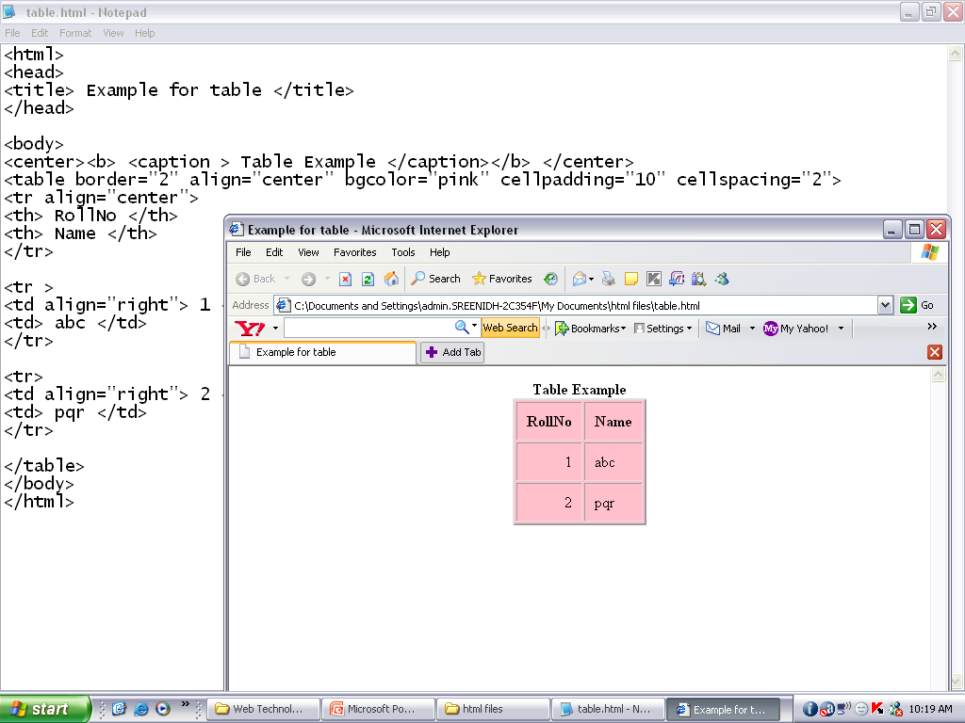
<!– Table Example→
<body>
<center><b> <caption > Table Example </caption></b> </center>
<table border="2" align="center" bgcolor="pink" cellpadding="10" cellspacing="2">
<tr align=“center”>
<th> RollNo </th>
<th> Name </th>
</tr>
<tr>
<td align=“right”> 1 </td>
<td> abc </td>
</tr>
<tr>
<td align=“right”> 2 </td>
<td> pqr </td>
</tr>
</table>

Slide 33
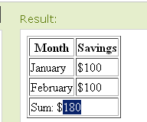
Example for colspan attribute of td tag
<table border="1">
<tr>
<th>Month</th>
<th>Savings</th>
</tr>
<tr>
<td>January</td>
<td>$100</td>
</tr>
<tr>
<td>February</td>
<td>$100</td>
</tr>
<tr>
<td colspan="2">Sum: $180</td>
</tr>
</table>

Slide 34
Lists
Opening Tag | Closing Tag | Attribute | Description
<OL> | </OL>
 |  | Type=“1 or a/A or i/I “ | Defines order type
 |  | Start= “integer number” | Specifies starting number/alphabet /roman number
<UL> | </UL>
 |  | Type=“square or circle or disk “ | Defines bullets type
<LI> | </LI> |  | List Item

Slide 35
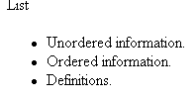
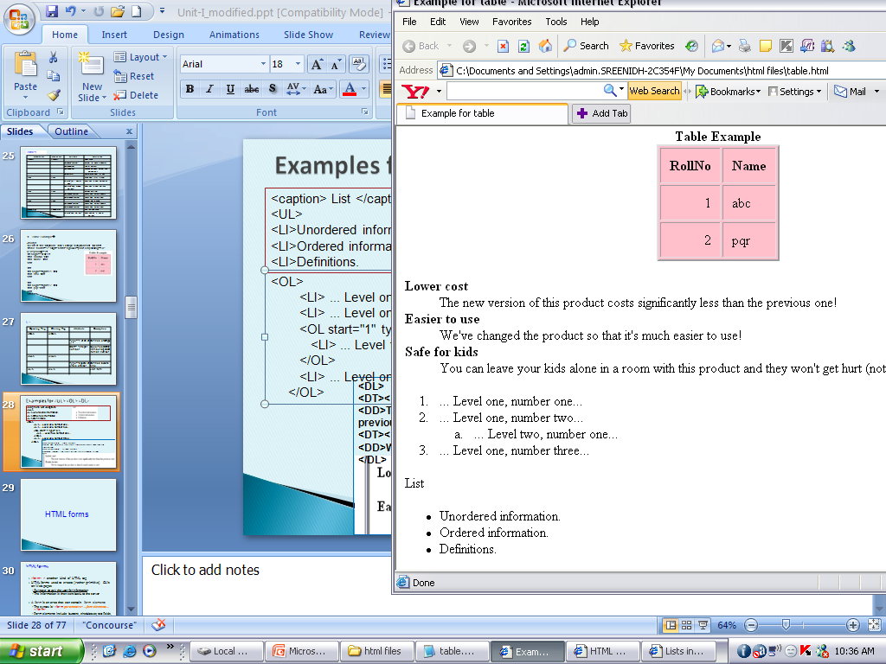
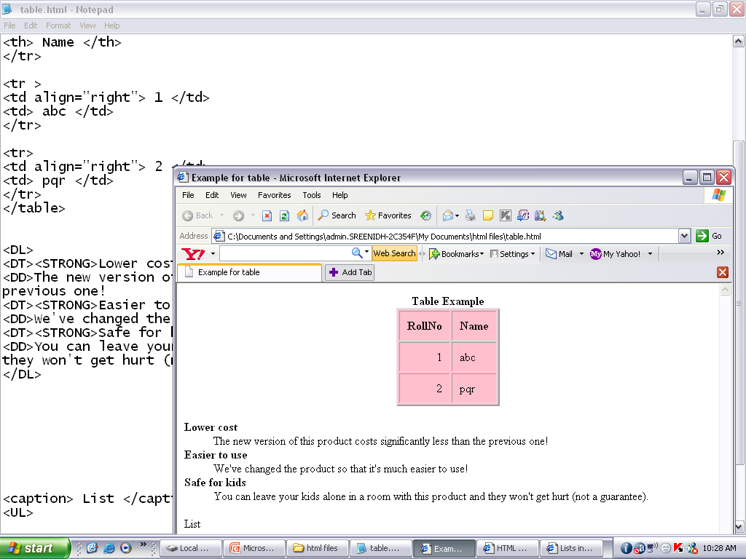
Examples for <UL> <OL> <DL>
<caption> List </caption>
<UL>
<LI>Unordered information.
<LI>Ordered information.
<LI>Definitions.
<OL>
<LI> ... Level one, number one...
<LI> ... Level one, number two...
<OL start="1" type="a">
<LI> ... Level two, number one...
</OL>
<LI> ... Level one, number three...
</OL>
<DL>
<DT><STRONG>Lower cost</STRONG>
<DD>The new version of this product costs significantly less than the
previous one!
<DT><STRONG>Easier to use</STRONG>
<DD>We've changed the product so that it's much easier to use!
</DL>

Slide 36
HTML forms

Slide 37
HTML forms
<form> :- another kind of HTML tag
used to create GUIs on Web pages
Purpose: to ask the user for information
The information is then sent back to the server
Area that can contain form elements
syntax <form parameters> ...form elements... </form>
Form’s parameters tell JavaScript how to send the information to the server

Slide 38
Forms
FormPage1
Name
ABC
SERVER
Address
…………….…..
………………..
…………………
Name,address, gender, interests
Gender
M
F
Designing WP
Writing
SUBMIT
Cycling
Reading
Form elements:
checkboxes, text fields, radio buttons, drop-down menus, etc
Other kinds of HTML tags can be mixed in with the form elements
Contains a Submit button to send the information in the form elements to the server

Slide 39
The <form> tag
<form parameters> ... </form> tag encloses form elements and other HTML
The parameters to form tell what to do with the user input
action="url" (required)
Specifies where to send the data when the Submit button is clicked
method="get" (default)
Form data is sent as a URL with ?form_data info appended to the end
Used if data is all ASCII and not more than 100 characters

Slide 40
The <form> tag (Contd.)
method="post"
Form data is sent in the body of the URL request
Cannot be bookmarked by most browsers
target="target"
Tells where to open the page sent as a result of the request
target= _blank means open in a new window
target= _top means use the same window
target= <framename> means use the same window

Slide 41
The <input> tag
form elements use the input tag, with a type="..." argument to tell which kind of element it is.
Other input tag arguments :
name: the name of the element
value: the initial value of the element
readonly: the value cannot be changed
disabled: the user can’t do anything with this element
Other arguments are defined for the input tag but have meaning only for certain values of type

Slide 42



Text input
A text field:
<input type="text" name="textfield" value="with an initial value">
A multi-line text field
<textarea name="textarea" cols="24" rows="2">Hello</textarea>
A password field:
<input type="password" name="textfield3" value="secret">
• Note that two of these use the input tag, but one uses textarea

Slide 43
Checkboxes
A checkbox: <input type="checkbox" name="checkbox” value="checkbox" checked>
type: "checkbox“
name: used to reference this form element from JavaScript
value: value to be returned when element is checked
Note that there is no text associated with the checkbox—you have to supply text in the surrounding HTML

Slide 44
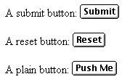
Buttons
A submit button: <input type="submit" name="Submit" value="Submit">
A reset button: <input type="reset" name="Submit2" value="Reset">
A plain button: <input type="button" name="Submit3" value="Push Me">
submit: send data
reset: restore all form elements to their initial state
button: take some action as specified by JavaScript
• Note that the type is input, not “button”

Slide 45

Radio buttons
Radio buttons:<br> <input type="radio" name="radiobutton" value="myValue1"> male<br> <input type="radio" name="radiobutton" value="myValue2" checked> female
If two or more radio buttons have the same name, the user can only select one of them at a time
This is how you make a radio button “group”
If you ask for the value of that name, you will get the value specified for the selected radio button
As with checkboxes, radio buttons do not contain any text

Slide 46

Drop-down menu or list
A menu or list: <select name="select"> <option value="red">red</option> <option value="green">green</option> <option value="BLUE">blue</option> </select>
Additional arguments:
size: the number of items visible in the list (default is "1")
multiple: if set to "true", any number of items may be selected (default is "false")

Slide 47
Hidden fields
<input type="hidden" name="hiddenField" value="nyah"> &lt;-- right there, don't you see it?
What good is this?
All input fields are sent back to the server, including hidden fields
This is a way to include information that the user doesn’t need to see (or that you don’t want her to see)
The value of a hidden field can be set programmatically (by JavaScript) before the form is submitted

Slide 48
A complete example
<html> <head> <title>Get Identity</title> </head> <body> <p><b>Who are you?</b></p> <form method="post" action=""> <p>Name: <input type="text" name="textfield"> </p> <p>Gender: <input type="radio" name="gender" value="m">Male <input type="radio" name="gender" value="f">Female</p> </form> </body> </html>

Slide 49
Frames

Slide 50
HTML frames are used to divide your browser window into multiple sections
where each section can load a separate HTML document.
A collection of frames in the browser window is known as a frameset
To use frames on a page we use <frameset> tag instead of <body> tag.
The <frameset> tag defines how to divide the window into frames.

Slide 51
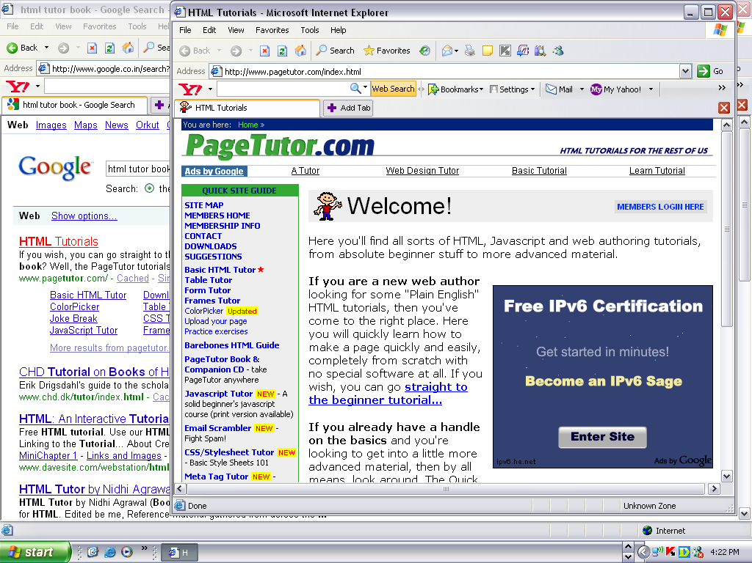
A way to split up what is viewed in the browser into sections
Difference between Frame and tables :IN EACH FRAME you can VIEW a SEPARATE HTML FILE

Slide 52
Frame Syntax (In Code View)
<frameset></frameset> Replaces the <body> tag in a frames document; can also be nested in other framesets
<frameset rows="value, value"> Defines the rows within a frameset, using number in pixels, or percentage of width
<frameset cols="value,value"> Defines the columns within a frameset, using number in pixels, or percentage of width
<frame> Defines a single frame — or region — within a frameset
<noframes></noframes> Defines what will appear on browsers that don't support frames

Slide 53
What is <noframe>
Browser Support for Frames
If a user is using any old browser or any browser which does not support frames then <noframes> element should be displayed to the user.
So you must place a <body> element inside the <noframes> element because the <frameset> element is supposed to replace the <body> element, but if a browser does not understand <frameset> element then it should understand what is inside the <body> element which is contained in a <noframes> element.
You can put some nice message for your user having old browsers. For example Sorry!! your browser does not support frames.

Slide 54
Frame Attributes
<frame src="URL"> Specifies which HTML document should be displayed
<frame name="name"> Names the frame, or region, so it may be targeted by other frames
<frame marginwidth=#> Defines the left and right margins for the frame; must be equal to or greater than 1
<frame marginheight=#> Defines the top and bottom margins for the frame; must be equal to or greater than 1
<frame scrolling=VALUE> Sets whether the frame has a scrollbar; value may equal "yes," "no," or "auto." The default, as in ordinary documents, is auto.
<frame noresize> Prevents the user from resizing a frame

Slide 55
Example
<html>
<head>
<title>HTML Frames</title>
</head>
<frameset rows="10%,80%,10%">
<frame name="top" src="/html/top_frame.htm" />
<frame name="main" src="/html/main_frame.htm" />
<frame name="bottom" src="/html/bottom_frame.htm" />
<noframes>
<body>
Your browser does not support frames.
</body>
</noframes>
</frameset>
</html>

Slide 56
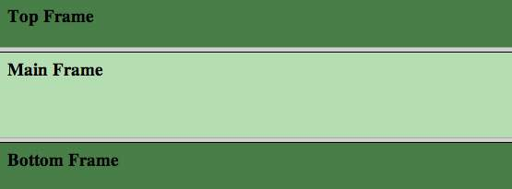
Results

Slide 57
How do I create a Frame?
Let’s create a page that has a left hand menu and a right hand content area where when we click on the menu links the content on the right hand side changes

Slide 58
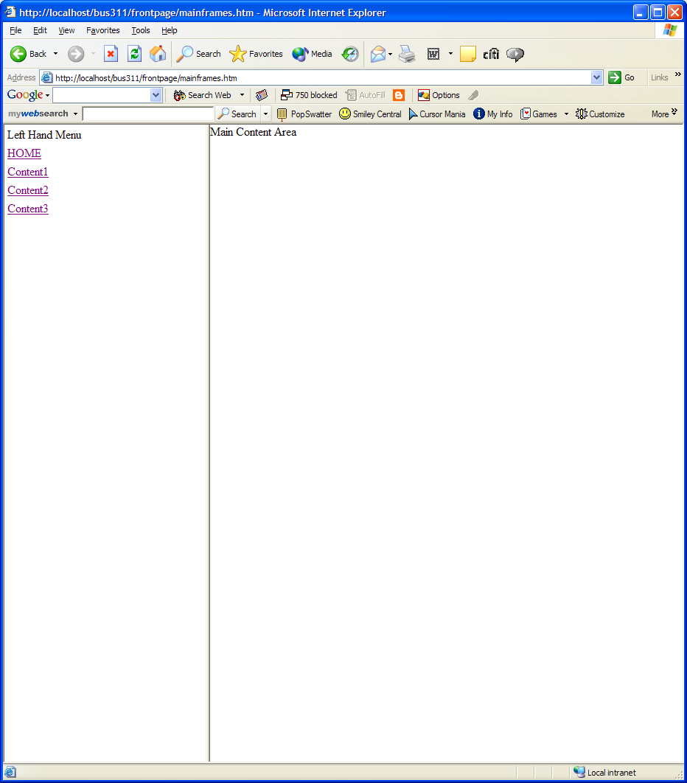
So this is what we want to Create!

Slide 59
So First we need to create 4 simple HTML files for the main content area
4 HTML files
Filenames are:
Home.htm
Content1.htm
Content2.htm
Content3.htm

Slide 60
Now let’s create the left hand menu file
This File needs the list of links
Home → Links to Home.htm
Content1 → Links to Content1.htm
Content2 → Links to Content2.htm
Content3 → Links to Content3.htm
Each link should have its properties set so that: “Target = MainContentArea” → this is where it points to which frame the html file will be displayed in.
Save this file as “LeftMenu.htm”

Slide 61
Let’s create our frame page that splits the browser and loads our default pages
In Code view (Save file as FrameExample.htm):
Code
What it does
<frameset cols="30%,*">
<frame name="LeftMenu" src="leftMenu.htm" marginwidth="0" marginheight="0" scrolling="auto" frameborder="1">
<frame name="MainContentArea" src=“Home.htm" marginwidth="0" marginheight="0" scrolling="auto" frameborder="1">
</frameset>
Splits browser into 2 vertical areas. First is a column that is 30% of the width of the browser window, second is rest of the browser window
This is the left frame and it is called “LeftMenu”. The default source to be displayed in this frame is “leftMenu.htm” NOTE: Any changes to “leftMenu.htm” will appear on all pages
This is the main area for content and is a frame called “MainContent”. The default source to be displayed in this frame is “Home.htm”
This is the closing tag saying that there are no more frames in this frameset

Slide 62
Now we need to try out our pages
Move all the pages to your folder
Home.htm
Content1.htm
Content2.htm
Content3.htm
LeftMenu.htm
FrameExample.htm
Open the file “FrameExample.htm” in your Browser

Slide 63
Option 1 – Global horizontal menu bar
Nest a second frameset into your initial frameset as shown below:
Save file as “FrameExample2.htm”
<frameset cols="30%,*">
<frame name="LeftMenu" src="LeftMenu.htm“ >
<frameset rows="50,*">
<frame name="TopMenu" src="TopMenu.htm“ >
<frame name="MainContent" src="MainContent.htm“ frameborder="1">
</frameset>
</frameset>

Slide 64
Let’s View our Work
Copy the Files you created over to your folder
FrameExample2.htm
TopMenu.htm

Slide 65
Disadvantages of Frames
There are few drawbacks with using frames, so it's never recommended to use frames in your web pages:
Some smaller devices cannot cope with frames often because their screen is not big enough to be divided up.
Sometimes your page will be displayed differently on different computers due to different screen resolution.
The browser's back button might not work as the user hopes.
There are still few browsers that do not support frame technology.

Slide 66
Cascading Stylesheets (CSS)

Slide 67
Definitions
CSS
Used to describe the presentation of a document written in a mark up language.
CSS is style sheet language used for describing the look and formatting of a document.
Style were added to html4.0 in 1996
To define color, fonts, layout and other aspects of document presentation.
Purpose: Separate document structure from document presentation.

Slide 68
Common CSS Syntax
h1 { color: #0000FF; font-size: 24pt; }
Selector
Declarations
Value
Property

Slide 69
CSS rule set consists of Selector and a declaration block.
The Selector points to the HTML Element you want to style.
Declaration block contain more than one declaration seperated by semicolon
Each declaration include a property name and a value, seperated by colon

Slide 70
Types of CSS
Inline Styles
coded in the body of the web page as an attribute of an HTML tag.
Applies to the specific element that contains it as an attribute
Embedded Styles/Internal Style sheet
Defined in the header of a web page.
Apply to the entire web page document.
Linked / External Styles
coded in a separate text file.
This text file is linked to the web page by using a <link> tag in the header section.

Slide 71
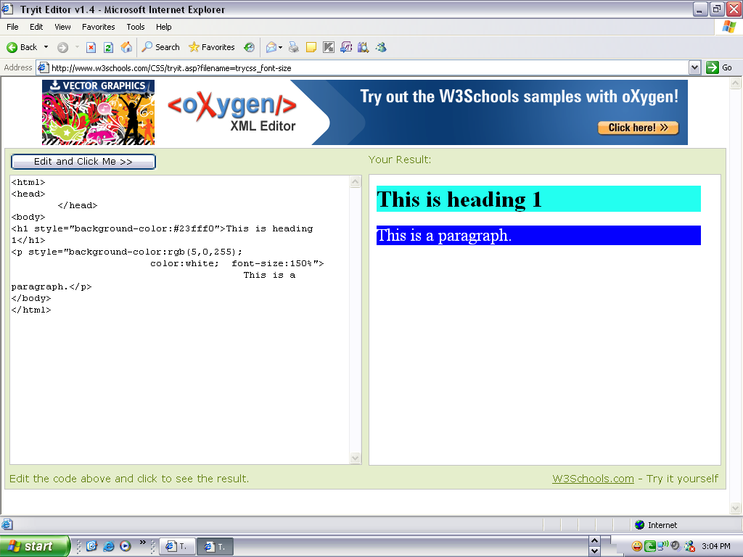
Inline CSS
<html>
<head>
</head>
<body>
<h1 style="background-color:#23fff0">This is heading 1</h1>
<p style="background-color:rgb(5,0,255);
color:white; font-size:150%">
This is a paragraph.</p>
</body>
</html>

Slide 72
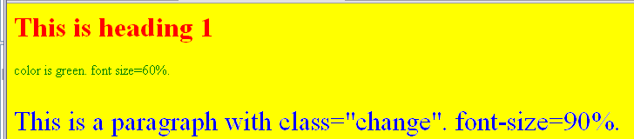
Embedded CSS
<html>
<style type="text/css">
body {background-color: yellow; color:red}
p {color:green; font-size=60%}
p.change { color:rgb(0,0,255); font-size:195%}
</style>
</head>
<body>
<h1>This is heading 1</h1>
<p> color is green. font size=60%.</p>
<p class="change">This is a paragraph with class="change". font-size=90%.</p>
</body>

Slide 73
Linked CSS
<html>
<head>
<link rel="stylesheet“
type="text/css“
href="style.css“ />
</head>
<body>
An external style sheet can be written in any text editor. The file should not contain any html tags. The style sheet file must be saved with a .css extension.

Slide 74
Grouping CSS Rules
Instead of this…
CSS: H1 { color: #FFFF00; } H2 { color: #FFFF00; }
You can do this… CSS: H1, H2 { color: #FFFF00; }

Slide 75
Classes
The class selector selects elements with a specific class attribute.
To select elements with a specific class, write a period (.) character, followed by the name of the class.
In the example below, all HTML elements with class="center" will be red and center-aligned:

Slide 76
<html>
<head>
<style> o/p:
p.center {
text-align: center; This heading will not be affected
color: red; This paragraph will be red and center-aligned
}
</style>
</head>
<body>
<h1 class="center">This heading will not be affected</h1>
<p class="center">This paragraph will be red and center-aligned.</p>
</body>
</html>

Slide 77
Classes
Allow styles for groups of elements CSS: .warning { color: red; } HTML: <h3 class=“warning”>
File not found.
</h3>

Slide 78
styles for specific elements
CSS: p.black {color: #000000;}
p.blue {color: #000080;}
HTML: <p class=“black”>
This sentence is black.
</p>
<p class=“blue”>
This sentence is blue.
</p>

Slide 79
Common CSS Properties
background-color
color
font-family
font-size
padding
margin
text-decoration
line-height
text-align
background-image

Slide 80
Fonts
font-family
Ordered list of font names
Quote names with spaces: ex. “Arial Black”
CSS: p.arial {
font-family: Arial, Helvetica, sans-serif;
}
font-size
larger, smaller, or specific height
CSS: p.big { font-size: 60px; }

Slide 81
Colors
color:
Named Colors: red, blue, green
Hex: #FFCC00, #FC0
RGB values: rgb(123, 123, 123)
CSS: p.green { color: #00FF00; }
background-color:
color or transparent
CSS: p.highlight { background-color: #FFCC00; }

Slide 82
Margins & Padding
Text Text Text Text Text Text Text Text Text Text Text Text Text Text Text Text Text Text Text Text Text Text Text Text
margin
padding
padding
margin
Margin
The space between this and other elements
margin-top, margin-right, margin-bottom, margin-left
margin: 5px 10px 5px 10px;
Values are in clockwise order

Slide 83
Margins & Padding
Text Text Text Text Text Text Text Text Text Text Text Text Text Text Text Text Text Text Text Text Text Text Text Text
margin
padding
padding
margin
Padding
The CSS padding properties define the white space between the element content and the element border.
The space between the margin and the element
padding-top, padding-right, padding-bottom, padding-left (can use same shortcut as with margins)
Comparable to TABLE’s cell-padding

Slide 84
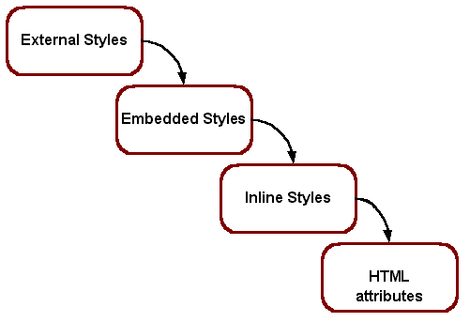
The Cascade
This “cascade” applies the styles in order from outermost (External / Linked Styles) to innermost (actual XHTML code on the page).
This way site-wide styles can be configured but overridden when needed by more granular (or page specific) styles.

Slide 85
CSS Benefits
CSS was a revolution in the world of web design.
control layout of many documents from one single style sheet;
more precise control of layout;
apply different layout to different media-types (screen, print, etc.)

Slide 86
Div
Div (short for division) divides the content into individual sections. Each section can then have its own formatting, as specified by the CSS. Div is a block-level container, meaning that there is a line feed after the </div> tag.

Slide 87
END

